Slide 1
Hoshin PDCA Reviews Leadership Guidelines

Slide 2
Purpose & Learning Objectives
Purpose:
To familiarize Members with a standardized process in which to conduct the monthly PDCA Review Meetings, as well as individual 2nd Level AIP Reviews.
Learning Objectives:
Monthly PDCA Review - Definition, Characteristics, Pitfalls
Identify the Monthly PDCA Review Checklist and Standards
Understand the Standard PDCA Meeting Agenda
Review the Hoshin War Room Layout
Understand the role of Leadership in the Monthly PDCA Review
Understand the role of Hoshin Team Members in the Monthly PDCA Review

Slide 3
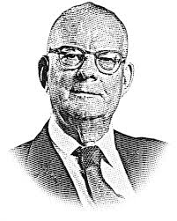
7 Phases of the Hoshin Process
Based on the Deming Cycle - PDCA
Develop LRP
Plan
Develop Long-Term Stretch Objectives
Catchball
Do
Check
Act
Develop AIPs, Targets Top Level
Develop AIPs, Targets, Resources - 2nd Level
Targeted
CI Efforts
8D
Counter-
measures
Implement AIPs
Monthly PDCA Review
We are here!
Annual Review
QUESTION: Where could be the failure point in your organization?
Notes:
DO: BREIFLY walk the group through this chart noting that you will be taking them through each step in the process in great detail. Key points to stress:
Strategic Deployment is a PROCESS.
The SD process is mirrored after the PDCA cycle.
You must do ALL of the steps to be successful.
Most companies fail by not implementing steps 5 & 6.
Just because you “Planned” does not mean you did SD.
Note the considerable amount of steps in “Plan” vs. other steps. This is typically a Japanese philosophy where they will spend more time in Planning and a small amount of time in the execution (DO) stage. This is sometimes the opposite thinking of traditional Western management.
SAY: “This cycle is based on the Deming Cycle, or the Plan-Do-Check-Act cycle. When leading with Strategic Deployment your business and its processes will continuously be at different points of implementing this cycle. Notice that it is a cycle (and there are cycles within the cycle) because continuous improvement never ends.

Slide 4
Monthly PDCA Review Defined
Definition
Characteristics
Pitfalls
A quality control checkpoint as to the progress the organization is making toward their Hoshin initiatives
A point where Leadership assesses the evolution of the organization’s problem-solving skillset
A meeting where resource allocation issues, roadblocks, and reprioritization decisions can be made
Leadership’s opportunity to:
  Resolve resource allocation issues,
  Eliminate roadblocks
  Make reprioritization decisions
  Determine Hoshin Team Members’ capability
  Provide coaching and feedback to Hoshin Teams
Leadership insists on offering solutions to the Hoshin Team
Leadership does not learn how to ask the right questions
Hoshin Teams are not prepared for the meeting
Only one person presents vs. a team approach
Discussion of non-Hoshin items
Not following the Hoshin agenda
Allowing Hoshin teams to PLAN-DO-CHECK-EXPLAIN vs PLAN-DO-CHECK-ACT
Do not allow PLAN-DO-CHECK-EXPLAIN!

Slide 5

Monthly PDCA Review Checklist
Establish Monthly PDCA Review schedule in advance
  PDCA Review Meeting should follow a standard cadence and occur as close to the month-end close as possible
Hoshin Teams to prepare:
  Bowling Chart
  Countermeasures (when targets are RED)
  Action Plan
Hoshin Teams should be prepared to discuss:
  RED items on the Bowler
  Rationale for countermeasures
  Resource constraints (current and/or emerging)
  Recommended changes to AIPs, Targets, AIP Priorities

Slide 6
PDCA Meeting Standard Agenda
TIME/CUM | ITEM | DESCRIPTION
10 min/10 min | INTRODUCTION | Introduce Hoshin Team Ground audience on your AIP and how it ties to the Top Level WPF Matrix Present Big Wins from previous month BRIEF areas of concern - more detail later
10 min/20 min | KEY FOLLOW-UP ITEMS FROM LAST MONTH | Review the status of the key follow-up items that were identified from last month’s PDCA meeting
45 min/65 min (Note: 15 minute limit per countermeasure) | COUNTERMEASURE REVIEW | General overview of bowling charts Outline the RED items on the bowling chart Review your countermeasure analysis for each RED item - show supporting detail as needed Tie the associated countermeasures with your action plan
10 min/75 min | BOTTLENECK - CONSTRAINT DISCUSSION | Discuss impediments to delivering your Action Plan on time, including resource constraints, talent constraints, outside support, etc.
15 min/90 min | WRAP-UP | Confirm newly created Key Follow-up items from this meeting - assign owner - reflect in Action Plan Confirm Parking Lot items - assign owner Respond to any questions as needed

Slide 7
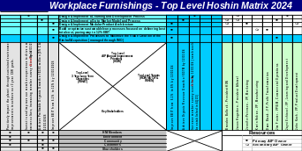
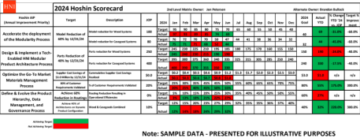
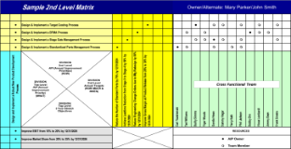
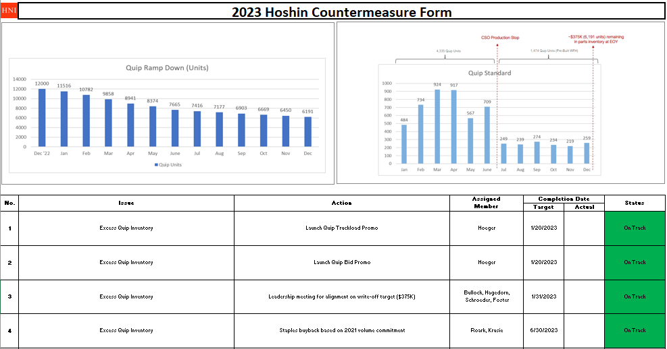
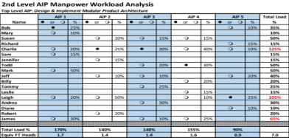
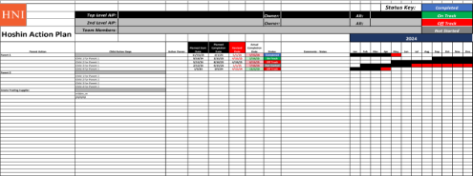
Hoshin War Room - Standardized Layout - Part 1
AGENDA
10 min – Introduction
10 min - Key F/U Items
45 min - Countermeasure Review
10 min - Constraint Discussion
15 min - Wrap-up
PLAN | TOP LEVEL MATRIX
 | 2nd LEVEL MATRIX
DO | RESOURCE ANALYSIS
DO | ACTION PLAN
CHECK | Bowling Chart
ACT | COUNTERMEASURE #1
 | COUNTERMEASURE #2
 | COUNTERMEASURE #3

Slide 8

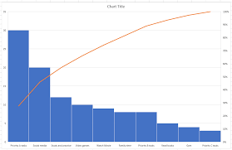
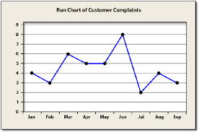
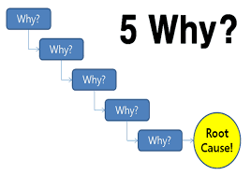
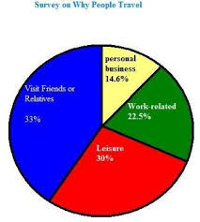

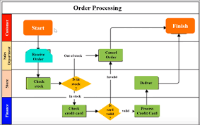
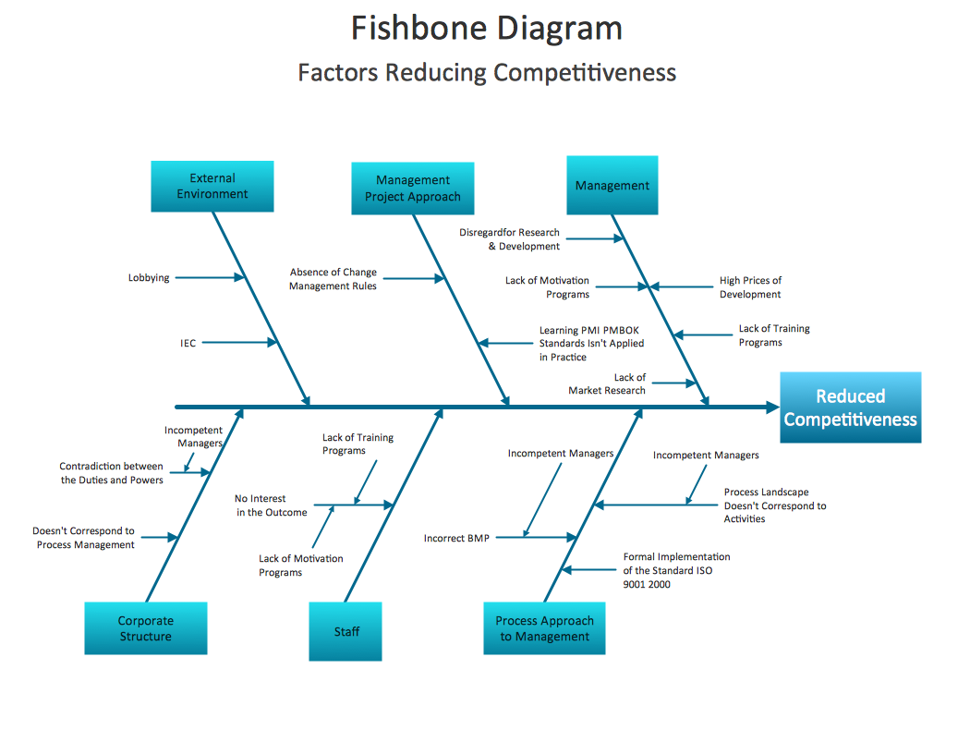

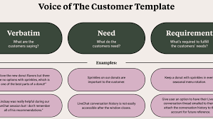
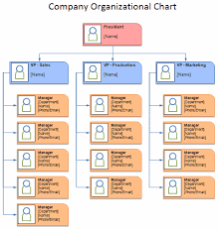
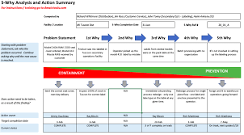
Hoshin War Room - Standardized Layout - Part 2
COUNTERMEASURES SUPPORTING DETAIL | COUNTERMEASURE #1
 | COUNTERMEASURE #2
 | COUNTERMEASURE #3
HOSHIN TEAM OPEN WORKSPACE
BIG WINS
KEY FOLLOW-UP ITEMS FROM LAST MONTH
KEY FOLLOW-UP ITEMS FOR THIS MONTH
PARKING LOT ITEMS
8

Slide 9
Role of Leaders
To ask the right questions, not give answers
Test the team’s understanding of their particular Hoshin
  Understand the situation with data
  Are targets being met with sustainable business processes?
In addition to RED items, occasionally ask,
  “Why did you go GREEN?”
Resolve resource conflicts
Assess if the team is “working the plan” by looking for RED signals on the Action Plan
Control the team’s tendency to “EXPLAIN” vs. “ACT”
Note: If teams are not prepared, dismiss them and schedule a follow-up team meeting within a week
“In God we trust, all others bring data.” - Dr. Edwards Deming

Slide 10

Role of Hoshin Team Member
All team members should present and be active participants
Presentation Cadence:
  Top Level Matrix
  2nd Level Matrix
  Bowling Chart
  Countermeasures (when targets are RED)
  Action Plan
2nd Level Team Leaders should report:
  Recommended changes to the AIP or Targets
  Recommended changes to AIP priorities
  Resource or training constraints
  Understand the situation with data
  Are targets being met with sustainable business processes?

Slide 11

Final Thoughts
It takes an organization 18 to 24 months until Hoshin is a natural part of their culture and DNA.
Developing your problem-solving muscle is the key to success.
Do not be discouraged!

